Slide 1
Credit Card
Defaulter Prediction
Group 18 (Runtime Terror): Dishant Vakte, Jeffi Edelbert, Rakshit Sinha, Yatin Koul, Zhanyi Zhu, Zheng Cen

Slide 2

Introduction
Defaulters could potentially cost banks a lot of revenue.
Banks need a concrete way to judge the credibility of its future customers before issuing a credit card or a loan.
Predicting if a customer will default or not, can be done based on various socio-economic factors.
Determining these factors will help the bank forecast and filter out defaulters.

Slide 3

About The Dataset
Direct marketing campaigns of a Portuguese banking institution; based on phone calls;
45211 instances and 17 attributes, total of 768,587 data points;
Attributes like default, marital, job, education, housing loan, etc
Highly imbalanced and requires resampling
Notes:
The data is related with direct marketing campaigns of a Portuguese banking institution which based on phone calls from customers.
It is a multivariable dataset contains 45211 instances and 17 attributes, which gives a total of 768,587 data points.
It contains Attributes like default which describes whether a customer has defaulted on the payment or not; marital, which shows marital status like single, married or divorce; housing loan shows whether the one have house loan or personal loan; job, education, … These categorical variables help to provide enough information for our following analysis.
After the pre-processing, we found the dataset is highly imbalanced and requires resampling;

Slide 4
Data Processing
Creating dummy variables for multiple categorical columns
Changing default variable to numerical column with binary values
Categorizing age column into bins
Detecting and removing outliers
Notes:
The original dataset contains some categorical variables as we have talked about before and we create dummy variables for these columns. Therefore, we can use these new created columns to perform statistical inferences and machine learning in later data analysis part.
Since we focus on detecting whether a client can become a defaulter or not, we also change this default column into a numerical column containing value which is either 1 or 0.
Besides, we set bins to the age column by classifying each ten year’s section as an age group. Therefore, we can more easily tell whether the people in a specific age group have a potential higher risk of becoming defaulters.
In addition, when we first looked these data we found the distribution of values in some columns are highly right skewed so that we defined the value which are 6 standard deviation away from the mean value as outliers and remove them to prevent these outliers’ side effects on the following study.

Slide 5
Data Analysis
01
02
03
Socio-economic factors
Correlation between variables
Machine Learning Models
Notes:
Our analysis includes exploring different variables related to socio-economic factors and determining which of them contribute to customers defaulting. We also analyzed correlation between different variables in the dataset which would help in building an efficient machine learning model to make predictions about new customers. Our final product is a machine learning model that will accurately predict if a customer has a high likelihood of defaulting.

Slide 6
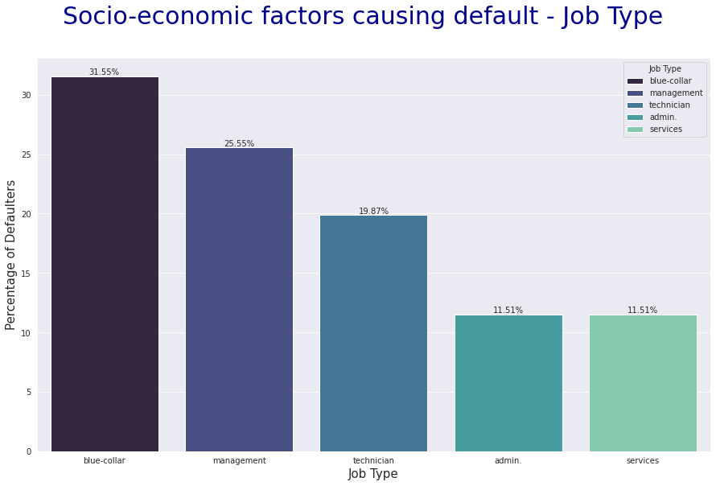
Notes:
After analyzing all socio-economic factors, we narrowed down to 3 factors which give us important insights. The first is Job Type. We see that blue collar workers have a higher likelihood of defaulting as compared to other job types. This can be attributed to the fact that blue collar jobs generally have a lower pay. And the most demand for these type of jobs are in metropolitan cities, where the cost of living is high. These factors contribute to financial instability which foster defaulting.

Slide 7
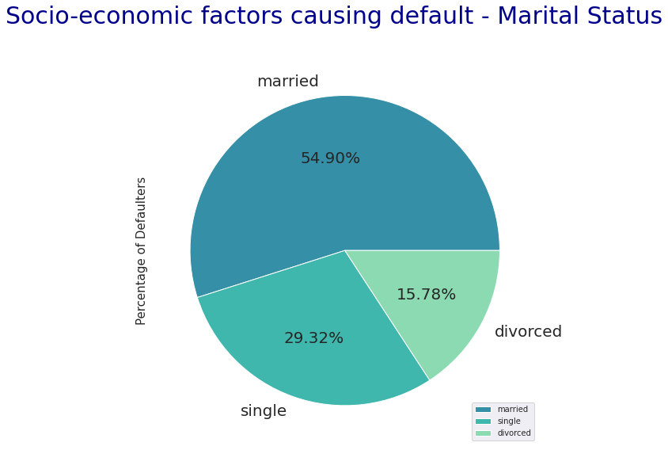
Notes:
We then analyze the marital status of customers that have defaulted and determined that married customers have a higher chance of defaulting at 54%. This could be because married individuals have more familial responsibilities, and if they have children, the expenses shoot up even more.

Slide 8
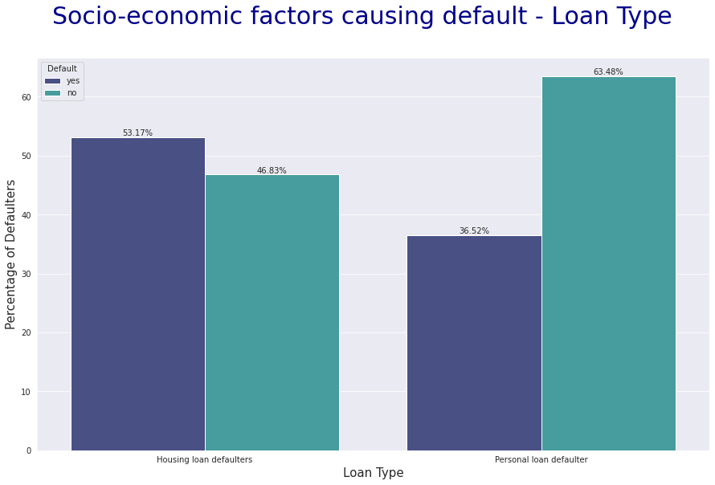
Notes:
When comparing how housing loans and personal loans affect customers, we see that housing loans have more of a financial impact on customers causing a high likelihood of defaulting as compared to personal loans. People usually take out a huge sum of money for housing loans, whereas personal loans are smaller sums of money. And a large chunk of their income goes in repaying the loan.

Slide 9
Socio-economic factors causing customers to default
Marital Status
Job Type
Loan Type
54.97% of defaulted customers are married.
31.21% of defaulted customers work a blue-collar job
53.37% of defaulters have a housing loan
Notes:
These are the statistics of our findings and it would be wise to exercise caution when issuing credit cards for customers falling under any of these categories.

Slide 10
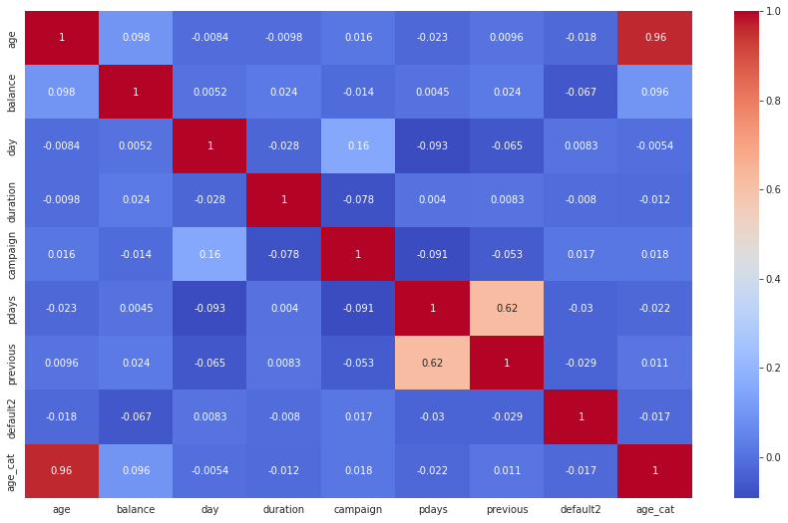
Heatmap to analyze correlation between various parameters
Notes:
We also analyzed the correlation between the different variables using a heatmap. As you can see the variables are not very correlated, which would mean that they would individually contribute to the machine learning model. This was an important step in ensuring that we build an efficient model using relevant parameters.

Slide 11
Implementing
Machine Learning Models
Machine Learning Algorithm: Random Forest
Re-sampling methods:
Undersampling
Oversampling
SMOTE

Slide 12
SMOTE
(Synthetic Minority Oversampling Technique)
A hybrid model of undersampling as well as oversampling.
Using data augmentation techniques, randomly generate new minority class data points.
By this, we achieve high number of “unique” minority class samples.
ML model will have a high number of samples to be trained on.

Slide 13
Random Forest
An ensemble learning algorithm using a number of “Decision Trees”, which works on creating a split based on various parametric values.
Random Forest is a good choice for highly imbalanced dataset
Ensemble learning allocates “weights” or “importance” to the target class - high weight for minority class and less weight for majority class.
Helps to build an efficient classification model.

Slide 14
Results
Undersampling
F-1 Score of 17% on the original test dataset (scaled). Underfitting
Oversampling
F-1 Score of 0% on the original test data (scaled). Severely overfitting
SMOTE
F-1 Score of 70% on the original test dataset (scaled). Good performance.

Slide 15
Conclusion
Customers falling under categories with high likelihood of defaulting such as married, working blue-collar jobs or having a housing loan could be offered higher interest rates.
This would ensure reduced risks for the firm and greater caution towards these customers.
Recommendation: This model can be built into an interface which allows executives to input information about a new customer and predict whether the customer is likely to default.

Slide 16
Thank You!

